Slide 1

Expansion module:
How can school staff help address stigma?
Notes:
This facilitation slide deck accompanies an expansion module to the one-hour Intro to MH LIT: Mental Health in Action course.

Slide 2

Notes for facilitation 2
This slide deck contains information to complement Intro to MH LIT, a one-hour mental health literacy course for educators. This slide deck offers related content in a format that may be offered at staff meetings or other professional learning opportunities.
Adjust the slides to meet your needs. They can be edited/reordered. Consider which optional extensions are relevant or fit within your allotted timeframe.
Consider supplementing the materials with additional activities/information specific to your region and board (e.g., local mental health programs or educational opportunities, etc.).
Consider inviting staff to complete the online course. It's free, self-paced, and a certificate is provided upon completion.
Notes:
https://smho-smso.ca/online-resources/intro-to-mh-lit/

Slide 3





Notes for facilitation 22
Materials needed:
sticky notes, pens
chart paper, markers
devices to access the online course (should you wish to introduce it as part of the learning)
Look for the following symbols to help with facilitation, as well as alignment with the course:

Slide 4

By the end of this module, we will be able to:
deepen your understanding of stigma related to mental illnesses
consider factors that contribute to mental health stigma
understand why mental health stigma is an issue
describe ways to decrease mental illness stigma

Slide 5
If the topic is personal to you…
Be gentle with yourself as you engage in this learning.
If it’s not a good day to engage with the topic, consider returning to the learning later.
If you need a break, take a break.
If you need a breath, take one (or use another strategy you prefer).
Know that mental illness does not define a person, and all of us, including those with mental illnesses, can be well and lead full and meaningful lives with the support we need and deserve.

Slide 6
Understand the topic
Notes:
This section corresponds to the main content of the learning.

Slide 7
Key terms
Prejudice: negative attitudes, beliefs and misconceptions towards another person or group of people based on aspects of their identity or situation in life | Discrimination: negative behaviour or unfair treatment that results from these attitudes, beliefs and misconceptions | Stigma: negative attitudes that unfairly place shame or disapproval and affect our decisions.
Notes:
Sources:
CMHA, Ontario Division (https://ontario.cmha.ca/documents/stigma-and-discrimination/)
Addressing Stigma | CAMH (https://www.camh.ca/en/driving-change/addressing-stigma)

Slide 8

By your side – understanding stigma video
Notes:
Watch this short video from By Your Side (School Mental Health Ontario’s website for parents and caregivers) to understand more about stigma.
By Your Side - Understanding Stigma (2:37) (https://smho-smso.ca/online-resources/stigma/)

Slide 9
Did you know?
There are three types of stigma: social stigma – stigma that is the result of the way society labels and stereotypes structural stigma – stigma related to laws, policies and institutional practices that increase prejudice, discrimination and barriers to getting help self-stigma – when we internalize negative messages about mental illness and start to accept and agree with them ourselves
Notes:
Invite a discussion about the various types of stigma. Which are most familiar? Which have the biggest impact? Why?

Slide 10
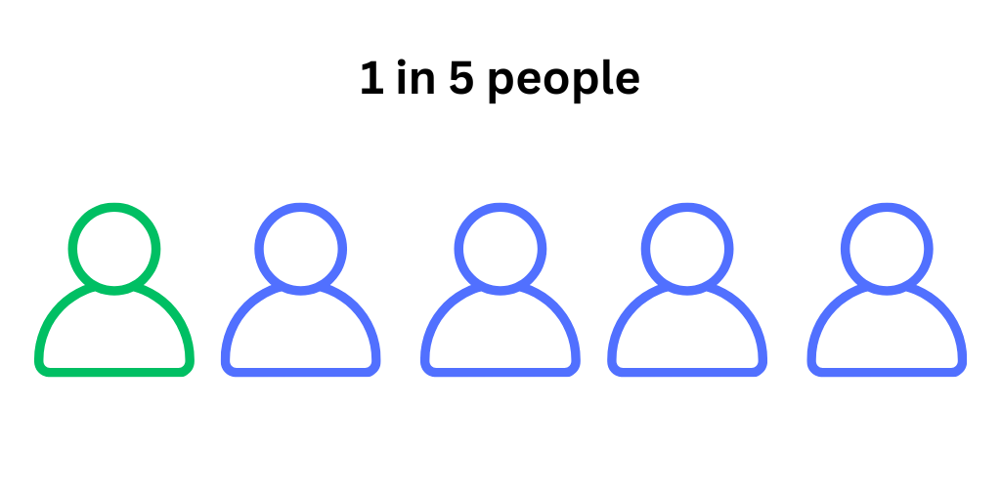
Why learn about stigma?
Notes:
Mental Health stigma is an important topic on both a professional and personal level:
Most of us know and care about someone who has experienced a mental health illness. The same is true for the students we serve.
In Ontario, 1 in 5 children and youth experience mental health concerns.
By age 40, half of us will have experienced a mental health concern.
Invite participants to be gentle, kind, and compassionate with each other through the learning, knowing this topic will be personal to many.
Source: Anti-Stigma - Mental Health Commission of Canada (https://mentalhealthcommission.ca/what-we-do/anti-stigma/)

Slide 11
Did you know? 2
Those experiencing stigma related to mental illnesses can experience other types of stigma, too. There can be multiple and intersecting layers of discrimination based on our multiple and intersecting identities (e.g., identities such as race, gender and orientation; circumstances related to substance use, housing and so on).
Notes:
Invite participants to consider various cultural perceptions of mental health and how they might influence stigma and affect how individuals view mental illness and seek help.

Slide 12
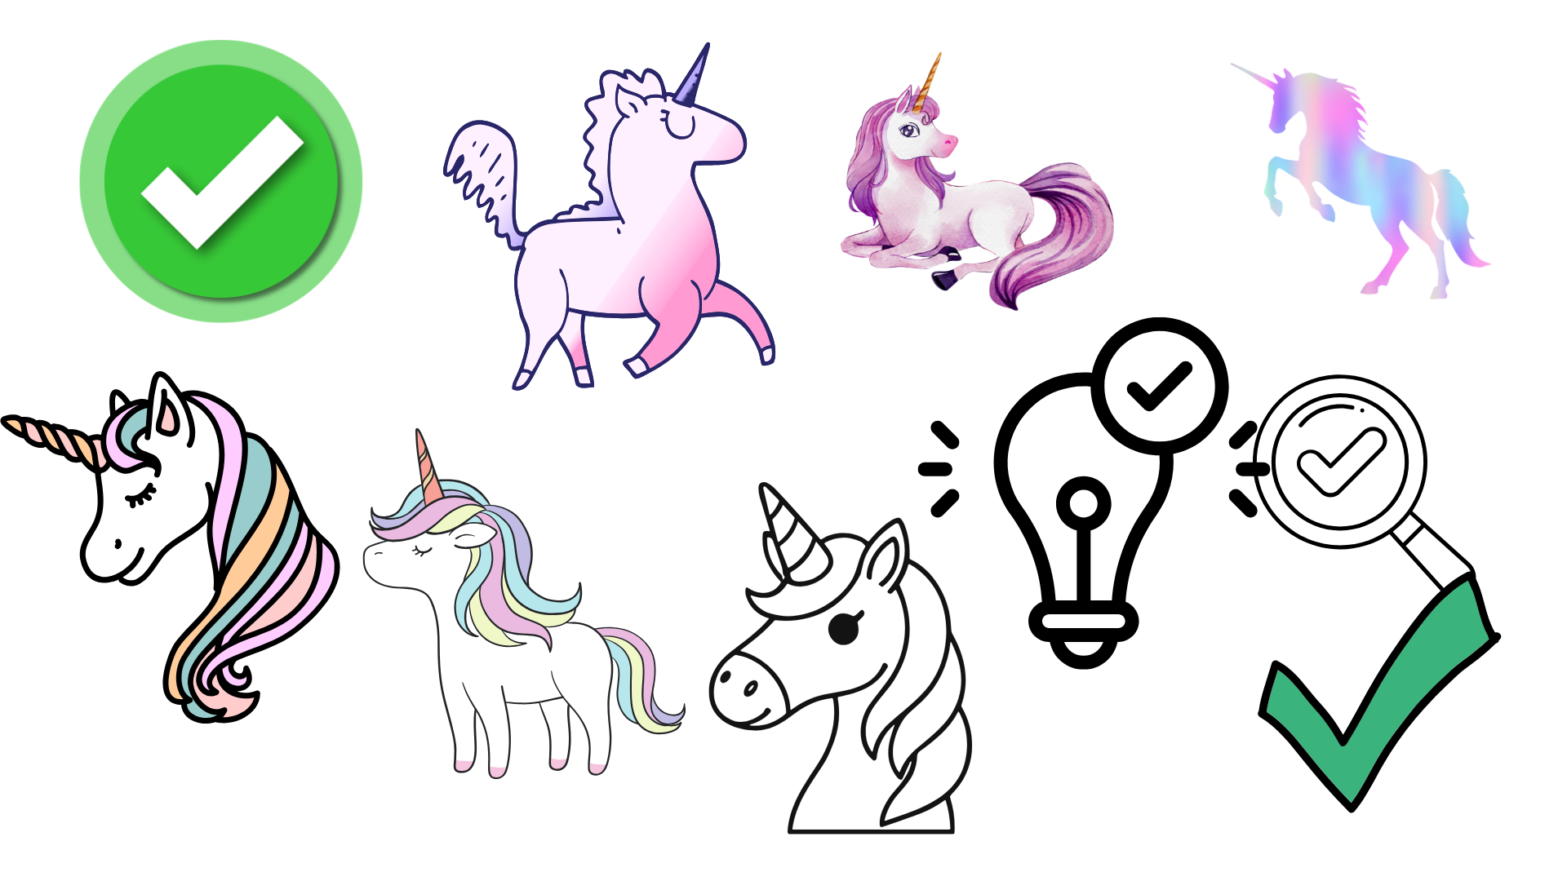
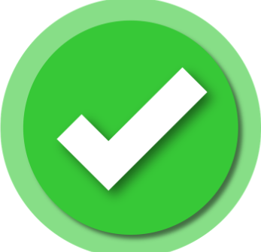
Myth or Fact 1
Myth
Fact
or

Slide 13
Myth or Fact 2
Myth
Fact
or
60% of people with a mental health concern or illness won’t seek help for fear of being labelled.

Slide 14
Myth or Fact 3
Myth
Fact
or
60% of people with a mental health concern or illness won’t seek help for fear of being labelled.
Notes:
This is a fact. In addition, about 40% of parents say they wouldn’t tell anyone (including the family doctor) if their child was experiencing a mental health concern.
Anti-Stigma - Mental Health Commission of Canada (https://mentalhealthcommission.ca/what-we-do/anti-stigma/)
Note: stigma around substance use is also a major barrier to seeking support.

Slide 15
Myth or Fact 4
Myth
Fact
or
Mental illness is
not a choice.

Slide 16
Myth or Fact 5
Myth
Fact
or
Mental illness is
not a choice.
Notes:
This is a fact. While we can do many things to influence our mental health and well-being, some factors that contribute to mental illness are beyond our control, such as our family history/genetics, aspects of our environment, the way we are treated by others, our access to supports, and so on. When we assume mental illness is a choice or blame those experiencing it, it can contribute to stigma and discourage support seeking.

Slide 17
Myth or Fact 6
Myth
Fact
or
People with mental illnesses are likely to be violent and unpredictable.

Slide 18
Myth or Fact 7
Myth
Fact
or
People with mental illnesses are likely to be violent and unpredictable.
Notes:
This is a myth. People with mental health concerns or mental illnesses are no more violent than any other group in our society. In fact, people with mental illnesses are actually more likely to be on the receiving end of violence than other groups.
Source: Canadian Mental Health Association (https://ontario.cmha.ca/documents/violence-and-mental-health-unpacking-a-complex-issue/)

Slide 19
Where does stigma come from?
Stigma can come from the way society and our communities understand and talk about mental health and mental illness.
Some perceptions exist because of misunderstandings and stereotypes that have been around for a long time and continue to be reinforced.
Notes:
Ask participants to reflect on their own school experience. Did it include any learning about mental health and mental illness? When did they first encounter this learning? What was the content at that time?

Slide 20
Where does stigma come from? 2
Media and the entertainment industry play an important role in influencing opinions about mental health and mental illness.
In some situations, social media has played a positive role in starting conversations about mental health that can reduce stigma. It can also play a role in spreading misinformation, perpetuating stereotypes and reinforcing stigma.
Notes:
Invite participants to reflect on the role media and the entertainment industry play in influencing opinions about mental health and mental illness. How might social media play a positive role? How might it play a negative one?

Slide 21
Where does stigma come from? 3
Stigma can be influenced and impacted by already entrenched cultural, racial, gender and faith views that associate mental illness with weakness and shame.
This can discourage appropriate help-seeking and encourage ineffective supports or interventions.
Notes:
Invite participants to consider messaging that encourages those with mental illness to try harder to be well. What would it be like if we used similar messaging for physical health concerns?

Slide 22
Reflect
Which do you encounter more often?
media stories that sensationalize a violent act by a person experiencing a mental illness
media stories about recovery or other positive news about a person's experience with mental illness
Notes:
Invite participants to consider why this imbalance exists, and how we might change it.

Slide 23

What is the impact of stigma?
affect the well-being of those experiencing it
affect the way people see themselves and the way others see them
contribute to isolation
discourage help-seeking
impact our sense of hope
create barriers to care
It’s important to address stigma related to mental health and mental illness because it can:
Notes:
Facilitator script: "Feeling respected as an individual with unique needs is a critical part of positive mental health for everyone, including those experiencing mental illness."

Slide 24
What can school staff do?
Notes:
Facilitator script: "Schools are an ideal place to challenge and dismantle mental health stigma. We're going to review a few tips to help."
Consider inviting additional ideas from participants as you move through the next few slides, and ideas about the ways they already contribute.

Slide 25
What can school staff do? 2
Educate yourself
Notes:
Educate yourself about mental health and mental illness.
Participants are already educating themselves by engaging in this module. Discuss other ways they can educate themselves, such as by participating in the foundational one-hour course or exploring the SMH-ON website.
Source: Addressing Stigma | CAMH (https://www.camh.ca/en/driving-change/addressing-stigma)

Slide 26
What can school staff do? 3
Self-reflect
Notes:
Examine your own beliefs, assumptions, biases, attitudes, and behaviours. These may be influenced by your experiences and identities, your knowledge or lack of knowledge, or the views of those around you. What have you learned about mental illness? What might you need to unlearn?
Invite participants to share where they have learned about mental health and mental illness. Has it been through family, friends, media, somewhere else? Where do they go for reliable information?
Source: Addressing Stigma | CAMH (https://www.camh.ca/en/driving-change/addressing-stigma)

Slide 27
What can school staff do? 4
Educate others
Notes:
Educate others. Pass on reliable information, challenge myths and stereotypes, and correct misunderstandings or assumptions.
Source: Addressing Stigma | CAMH (https://www.camh.ca/en/driving-change/addressing-stigma)

Slide 28
What can school staff do? 5
Talk about it
Notes:
Create environments where mental health is openly discussed. When we create safe spaces for talking about mental health and mental illness and encourage help-seeking, we also create understanding, compassion, and hope.
Invite ideas as to how we can create comfortable spaces to talk about mental health. What might students need? What might we need as adults?
Source: Addressing Stigma | CAMH (https://www.camh.ca/en/driving-change/addressing-stigma)

Slide 29
What can school staff do? 6
Choose words carefully
Notes:
Make thoughtful word choices. Our language can contribute to stigma and cause harm or it can empower others, create space for sharing experiences, and encourage help-seeking.
Reflect: Why do you think there continue to be issues with language around mental health and mental illness (e.g., mental illness diagnoses being used as adjectives)? What might help create more understanding of the harmful impact this can have?
Sources: Addressing Stigma | CAMH (https://www.camh.ca/en/driving-change/addressing-stigma)

Slide 30
What can school staff do? 7
Avoid assumptions
Notes:
Centre the preferences and needs of those experiencing a mental health concern. Remain open and curious about the perspectives of students and/or parents/caregivers. Avoid assumptions about what may support them.
Sometimes there are assumptions about what a student needs. For example, students are often encouraged to "journal" or engage in other frequently used and promoted strategies like deep breathing. However, this may not feel supportive to every student. Each student is unique, and different strategies will support each of them. The best way to learn about what a student and their parent/caregiver may experience as supportive, is to ask them rather than assuming all people with mental illness are the same.
Activity idea: invite participants to consider some currently popular strategies they may be encountering (e.g., on social media). Do they find the strategies personally helpful to support their well-being? Are there some they prefer more than others? The same will be true for students.

Slide 31
What can school staff do? 8
Treat everyone with dignity and respect
Notes:
Don’t define anyone by the mental illness they might be experiencing. Treat everyone with dignity and respect, offer support and encouragement, and convey a sense of hope.
Facilitator script: "Mental illness is a health condition, not a personal choice or character flaw."
Source: Addressing Stigma | CAMH (https://www.camh.ca/en/driving-change/addressing-stigma)

Slide 32

Ask yourself if messaging:
Stereotypes people experiencing mental illness
Trivializes people experiencing mental illness and/or the illness itself
Offends people experiencing mental illness
Patronizes people experiencing mental illness
Notes:
Use the Canadian Mental Health Association’s STOP criteria to recognize attitudes and actions that support stigma.
Ask yourself if messaging:
Stereotypes people experiencing mental illness (assumes people and their experiences are all alike, rather than individuals with unique stories and lives)
Trivializes or belittles people experiencing mental illness and/or the illness itself
Offends people experiencing mental illness
Patronizes people experiencing mental illness (treats individuals with mental illness as if they are not as important or worthwhile as other people)
Source: Stigma and Discrimination (https://ontario.cmha.ca/documents/stigma-and-discrimination/)

Slide 33
Did you know? 3
When School Mental Health Ontario connected with Ontario secondary school students, they said privacy was one of their biggest concerns about seeking mental health support. As school staff, we need to exercise care when students share mental health concerns with us. This does not mean never sharing information. It means sharing only the information needed and only with those who need it to help a student or keep them safe (e.g., asking a school mental health professional about appropriate next steps).
Notes:
Invite a discussion about who might need to know if a student shares a mental health concern. Who might not? Where and when could the information best be shared?
Note: students also often want to know if their parents/caregivers will be informed should they wish to connect with a school mental health professional. School boards have developed their own guidance on how referrals for these services are managed. Check in with your board's Mental Health Leader and/or Manager of School Mental Health Professional Services to understand more about the practices in your board and ensure you can provide accurate information to students, should they have concerns.

Slide 34
Explore strategies
Choose words carefully
Instead of... | Try...
It drives me crazy! That's insane/nuts. He suffers from depression. Mentally ill person | It bothers/annoys/frustrates me. This is interesting/strange/peculiar/funny. He lives with/is experiencing depression. Person living with a mental health concern or illness
Notes:
Facilitator script: "It's important to be thoughtful about how we communicate about mental illnesses. It may be very personal to someone close by. If you encounter someone communicating negatively, consider what you would want them to say if they were speaking about you, a friend, or a family member. Then help them change their words or provide an example with your own."

Slide 35
Student voice
"I think my words of wisdom are just to be mindful of the language that we use... our words hold weight."
–Ontario secondary school student

Slide 36
Build your toolbox

Slide 37
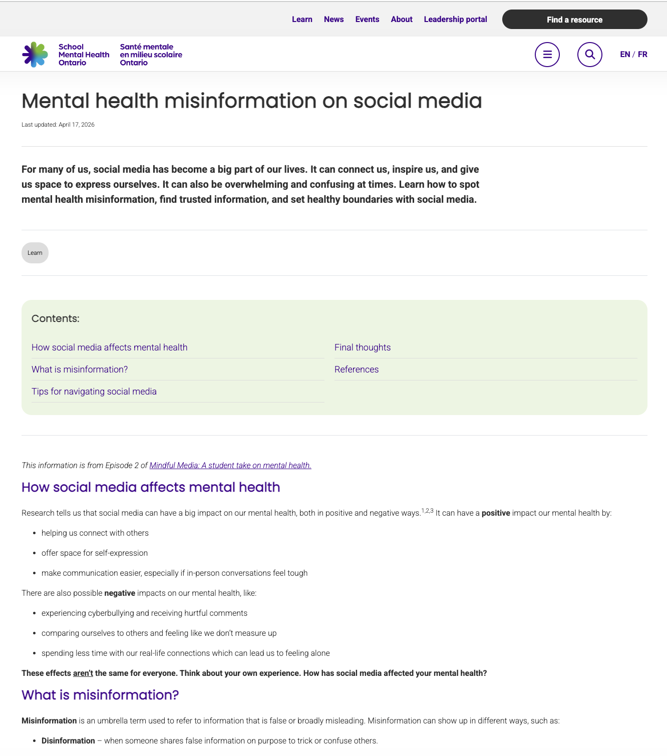
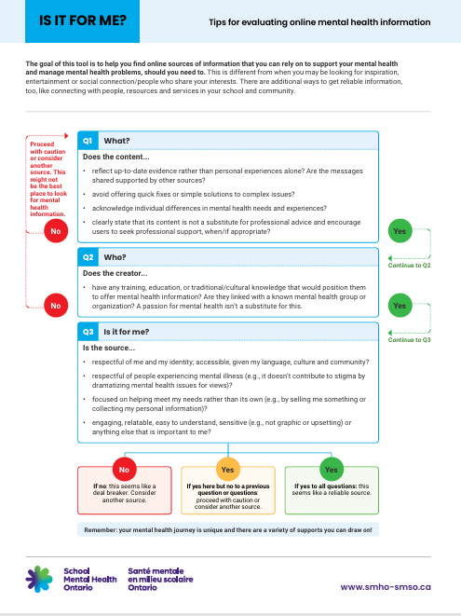
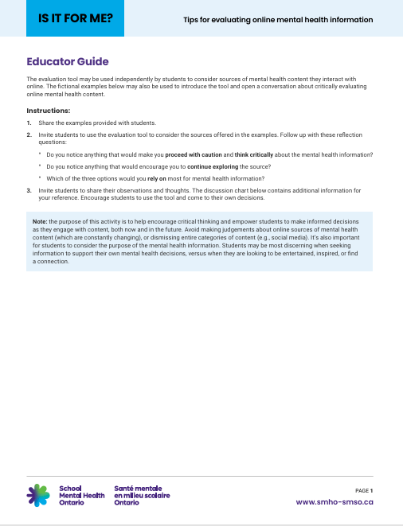
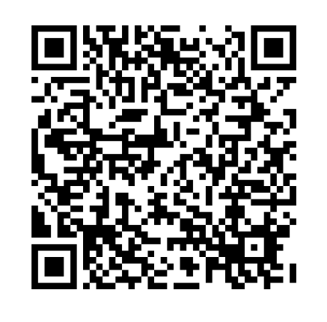
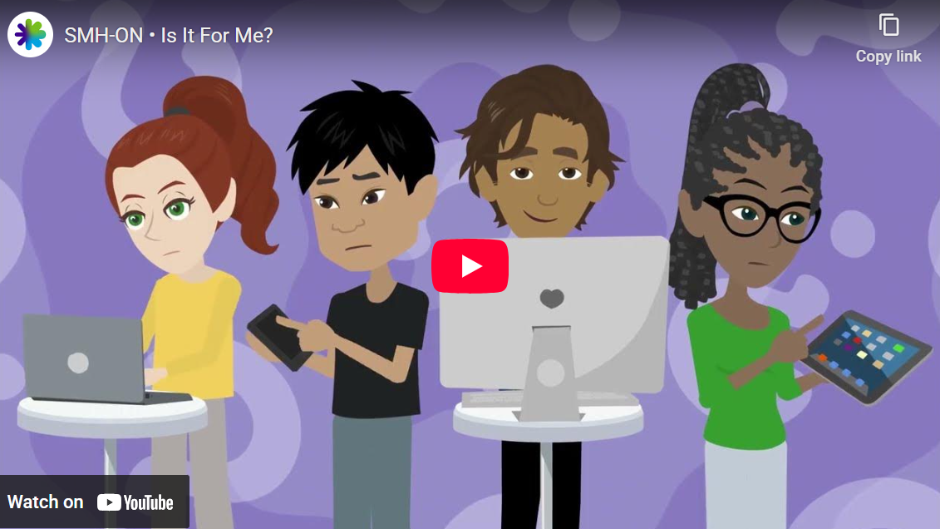
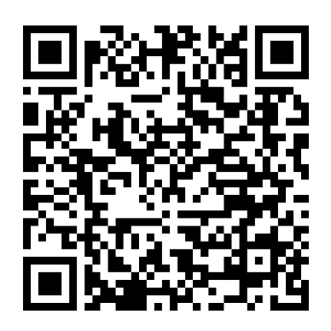
Supportive resources
Is it for me?
Mental health misinformation on social media
Notes:
https://smho-smso.ca/online-resources/is-it-for-me-tips-for-evaluating-online-mental-health-information/ - A simple tool designed to encourage critical thinking and empower students to make informed decisions as they engage with online mental health content.
https://smho-smso.ca/mental-health-misinformation-on-social-media/ - Information about how to spot mental health misinformation, find trusted information, and set healthy boundaries with social media. The information is taken from Episode 2 of Mindful Media: A student take on mental health (https://smho-smso.ca/navigating-mental-health-and-social-media-a-podcast-series/).

Slide 38
Dig deeper

Slide 39
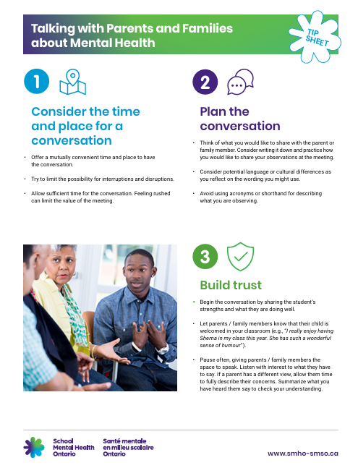
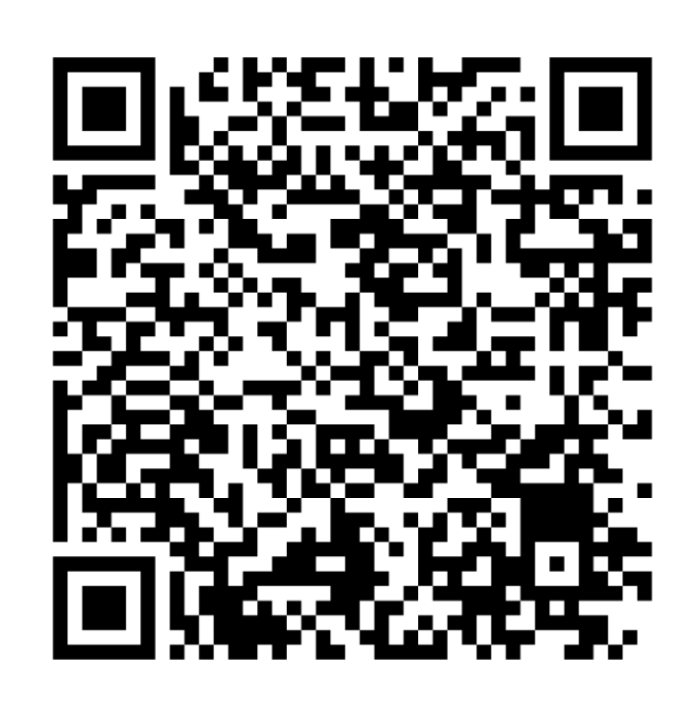
Talking with parents and families about mental health
This tip sheet provides ideas to consider when planning to meet and talk with parents and families.
Notes:
https://smho-smso.ca/online-resources/talking-with-parents-and-families-about-mental-health/
The way we communicate with parents and caregivers about concerns can also contribute to stigma or help reduce it.

Slide 40

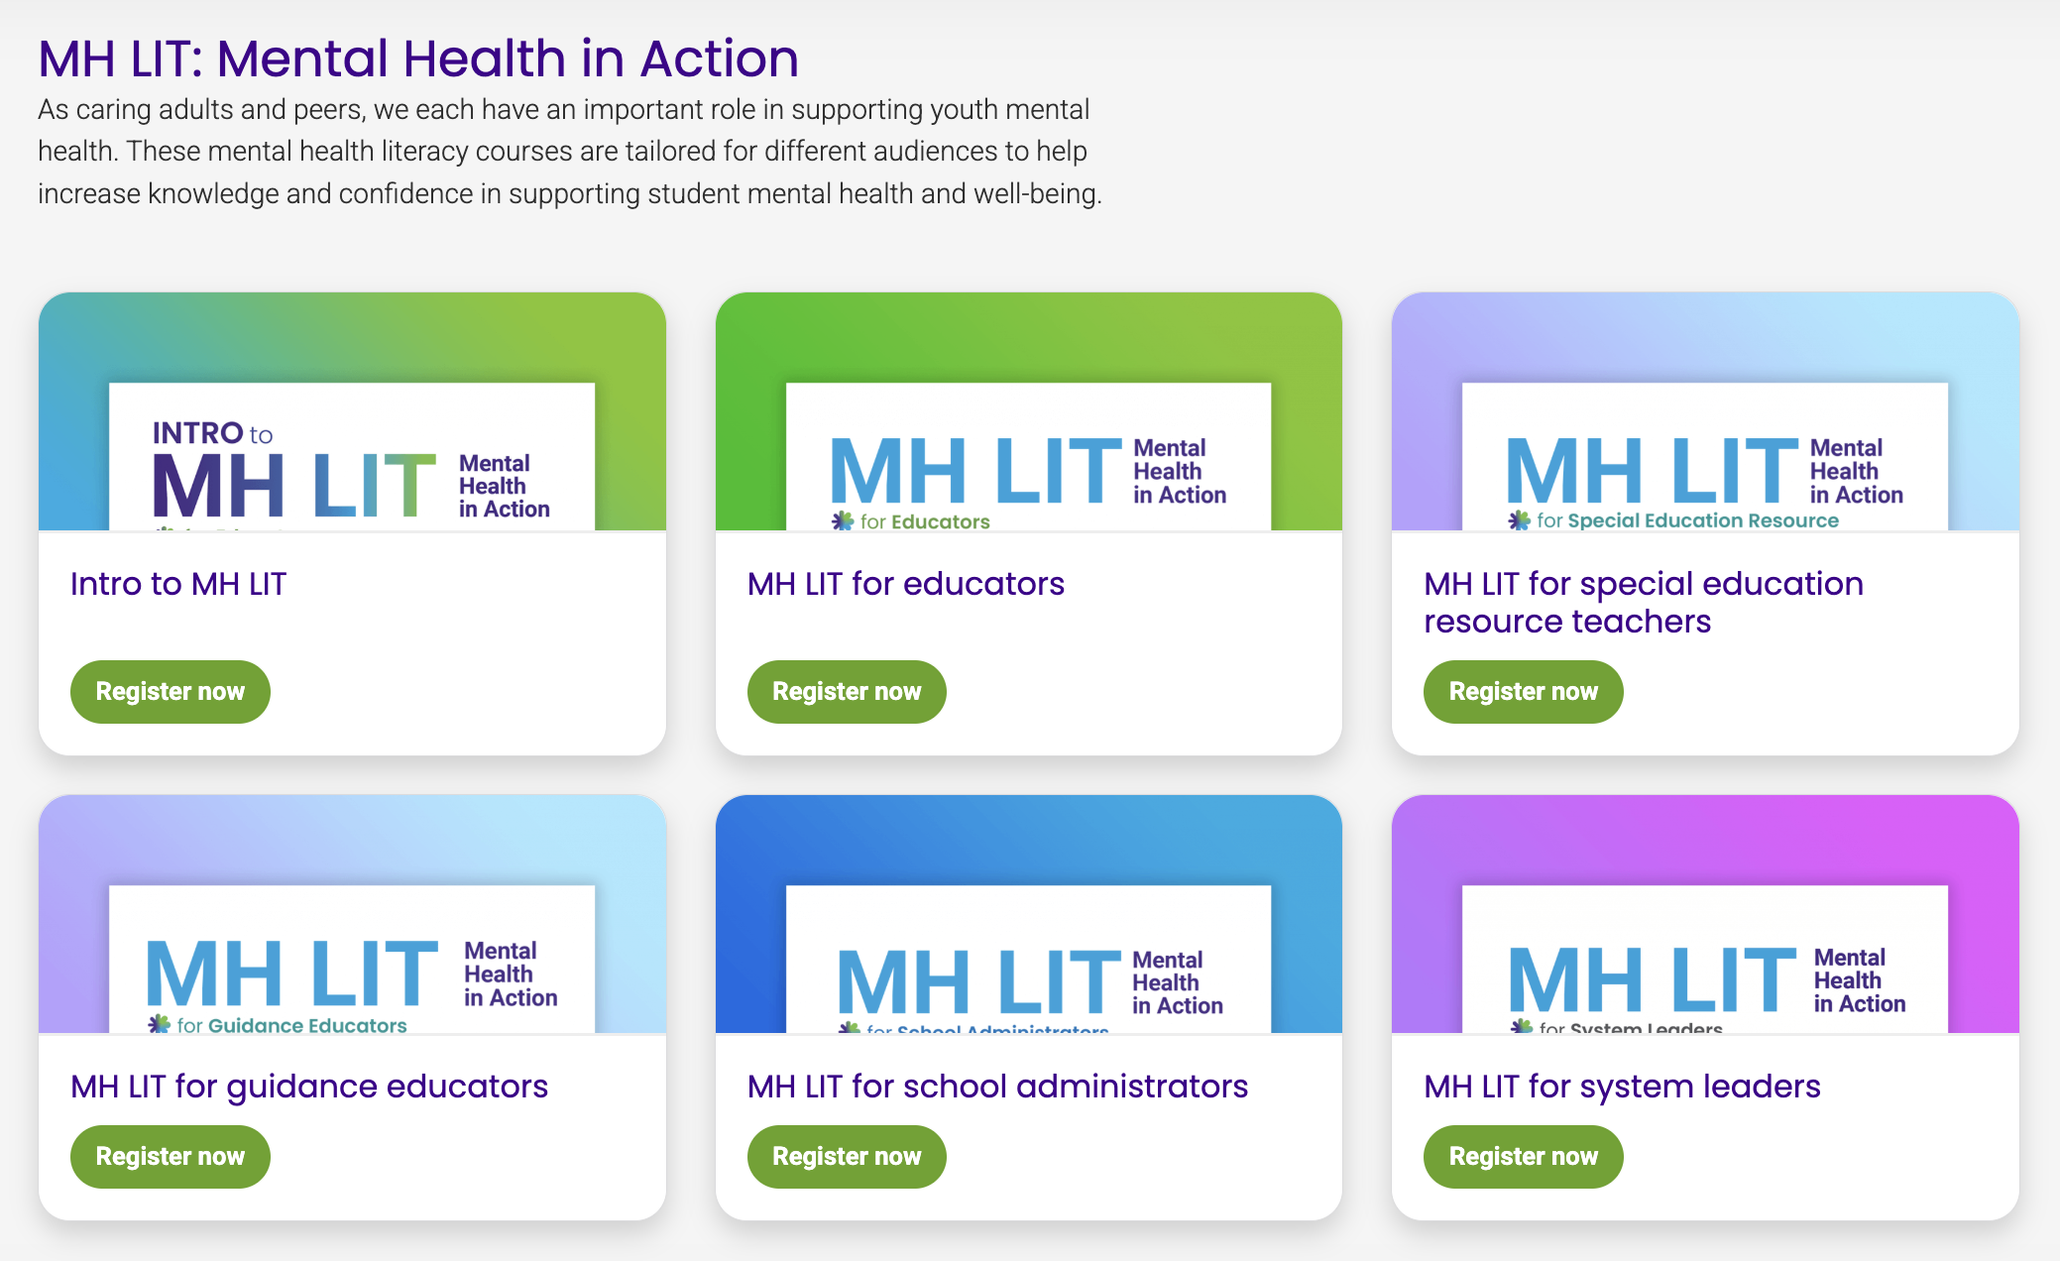
Connect with SMH-ON
Continue the learning by exploring the foundational Intro to MH LIT course for educators.
Notes:
Encourage participants to explore Intro to MH LIT (https://smho-smso.ca/online-resources/intro-to-mh-lit/) to continue their mental health literacy learning and sharing.

